Slide 1
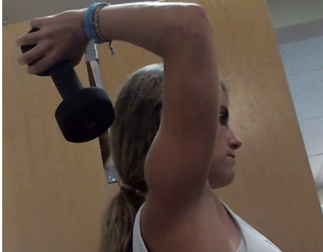
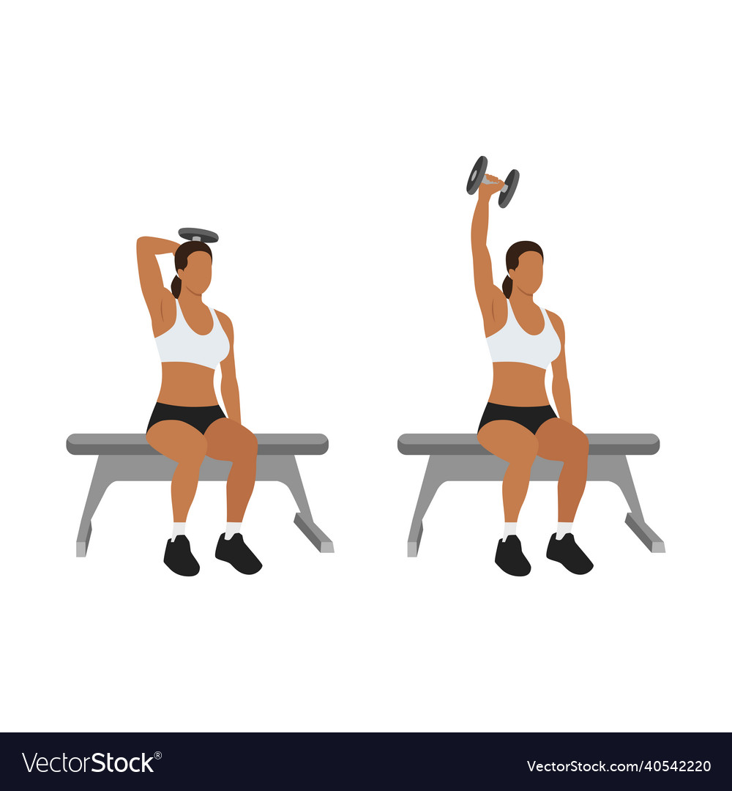
Limb system: forearm/hand
Joint: elbow
Overhead extension

Slide 2
Limb system: forearm/hand
Joint: elbow
Drag to show torque directions of the dumbbell and the weight of the forearm/hand and their lever arms.
4pts.
flexion
flexion
W_{arm}
10lb
dumbbell
extension
extension
r
r

Slide 3
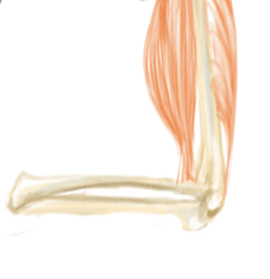
Which muscle provides the counter-torque?
4pts.
Biceps
Triceps
W_{arm}
Drag to show muscle force, its torque rotation direction, and lever arm
10lb
dumbbell
3pts.
M_{biceps}
M_{triceps}
flexion
extension
r

Slide 4
Take extension torque direction to be positive and flexion negative
Στ_{forearm/hand} = 0
4pts.
-
+
flexion
extension
Choose which torque balance equation is correct
+ 𝝉_{dumbbell} - 𝝉_{weight arm} + 𝝉_{muscle} = 0
- 𝝉_{dumbbell} - 𝝉_{weight arm} + 𝝉_{muscle} = 0
- 𝝉_{dumbbell} + 𝝉_{weight arm} - 𝝉_{muscle} = 0
+ 𝝉_{dumbbell} + 𝝉_{weight arm} + 𝝉_{muscle} = 0
For simplicity...
In the next part, we are going to look at the two largest torques ...thus neglect the weight of the forearm-hand

Slide 5
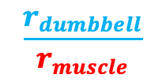
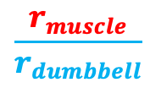
Torque Equilibrium condition
Στ = 0
Rearrange symbols below to show algebra
2pts.
τ_{muscle}
τ_{dumbbell}
=
F_{muscle}
F_{dumbbell}
r_{⊥muscle}
r_{⊥dumbbell}
Show algebraically how muscle force relates to ratio of lever arms in simple cases like this
τ_{dumbbell}
F_{muscle}
=
$$\frac{r_{muscle}}{r_{dumbbell}}$$
$$\frac{r_{dumbbell}}{r_{muscle}}$$
F_{dumbbell}
τ_{muscle}
r_{⊥dumbbell}
r_{⊥muscle}
1pt.

Slide 6
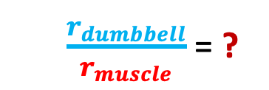
Redraw muscle force and lever arms
M
r
r
$\frac{r_{dumbbell}}{r_{muscle}}$ = ?
2pts.
Estimate ratio
dumbbell
10lb
Same question asked differently: How much larger is the dumbbell lever arm than the muscle lever arm?
2pts.
How much larger must the muscle force be than the dumbbell (to balance out the torque of the dumbbell?)
2pts.
2pts.
Approximate muscle force, if dumbbell is 10lbs.
Resize muscle force vector to display relative size to dumbbell vector
M = ? lbs.
2pts.

Slide 7
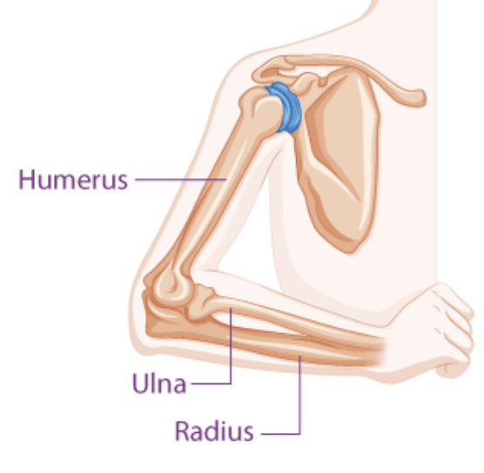
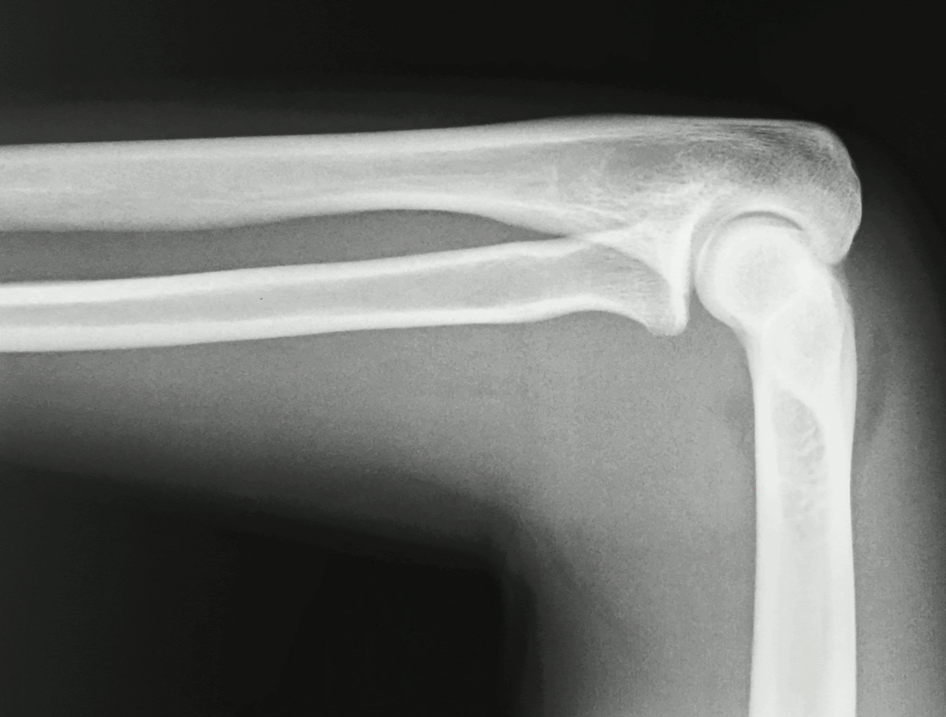
The force of the humerus on the radius and the force of the radius on the humerus are interaction force pairs
Joint force (humerus on radius)
tibia
Joint force (radius on humerus)
talus
https://byjus.com/biology/arm-bones-diagram/
https://www.aliem.com/emrad-ped-elbow/

Slide 8
Drag and resize muscle force vector, relative to F_{dumbbell} vector
2pts.
Drag and resize joint force vector Relative size matters
Force Equilibrium condition
ΣF = 0
Choose whether each term is positive or negative
± F_{muscle} ± F_{dumbbell} ± J = 0
4pts.
10lb
dumbbell
Calculate estimate for joint force and put answer in ? (Show work)
J = ? lbs.
2pts.

Slide 9
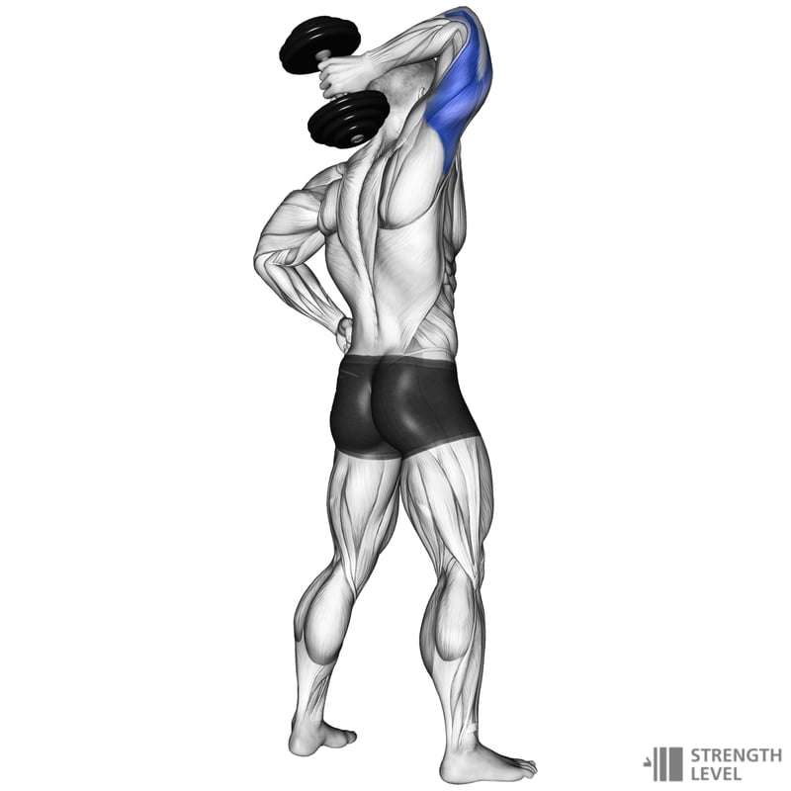
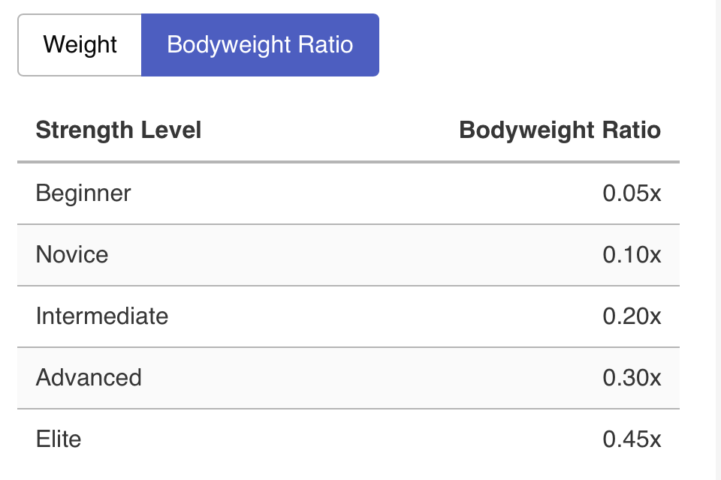
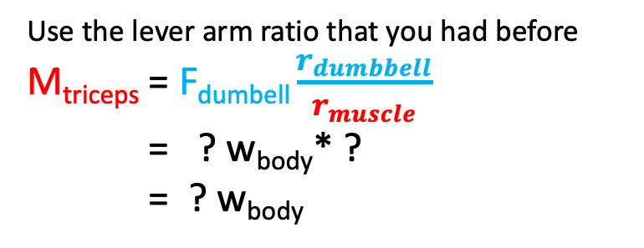
If she was at the Elite level
Female Dumbbell Triceps Extension Standards
What would her triceps muscle force be, in terms of body weight?
Use the lever arm ratio that you had before
M_{triceps} = F_{dumbell} $\frac{r_{dumbbell}}{r_{muscle}}$
= ? w_{body}* ?
= ? w_{body}
F_{dumbell} = ? w_{body}
https://strengthlevel.com/strength-standards/dumbbell-tricep-extension

Slide 10
What would her elbow joint force be, in terms of body weight?
2pts.
Force Equilibrium condition
ΣF = 0
J = ? w_{body}
J_{elbow} = ? w_{body}
± F_{muscle} ± F_{dumbbell} ± J = 0
0.45W_{body}
F_{muscle} =? w_{body}
J = ± F_{muscle} ± F_{dumbbell}
dumbbell
2pts.
4pts.

Slide 11


If we included the torque due the weight of the arm, would the muscle force result be bigger or smaller?
Then using simple ratio is not possible
10lb
W_{arm}
r_{⊥dumbbell}
$$\text{r}\text{Warm}$$

Slide 12
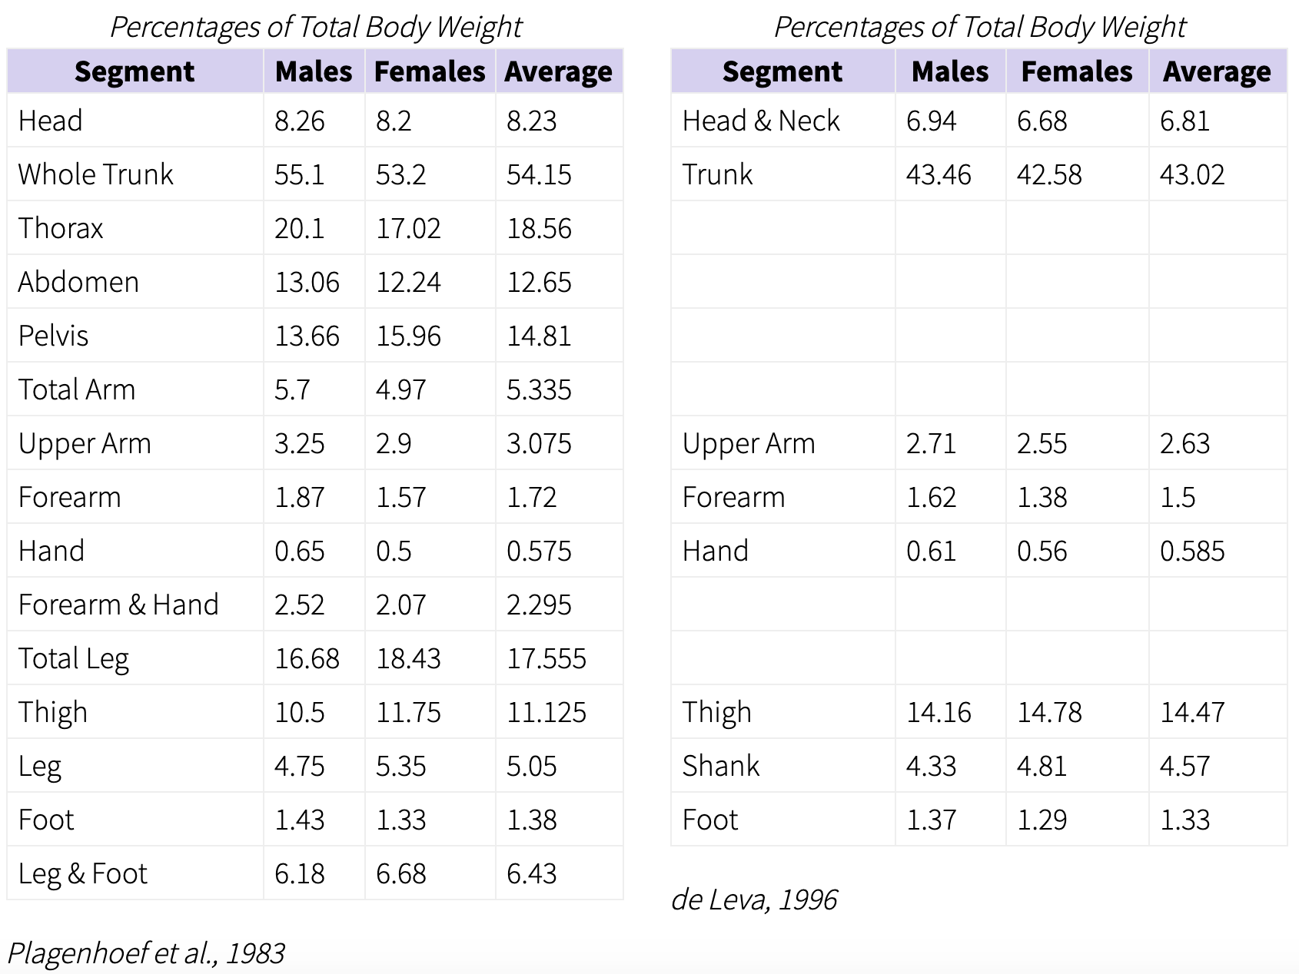
W_{arm} = 0.02* 115lbs
= ?
https://exrx.net/Kinesiology/Segments

Slide 13
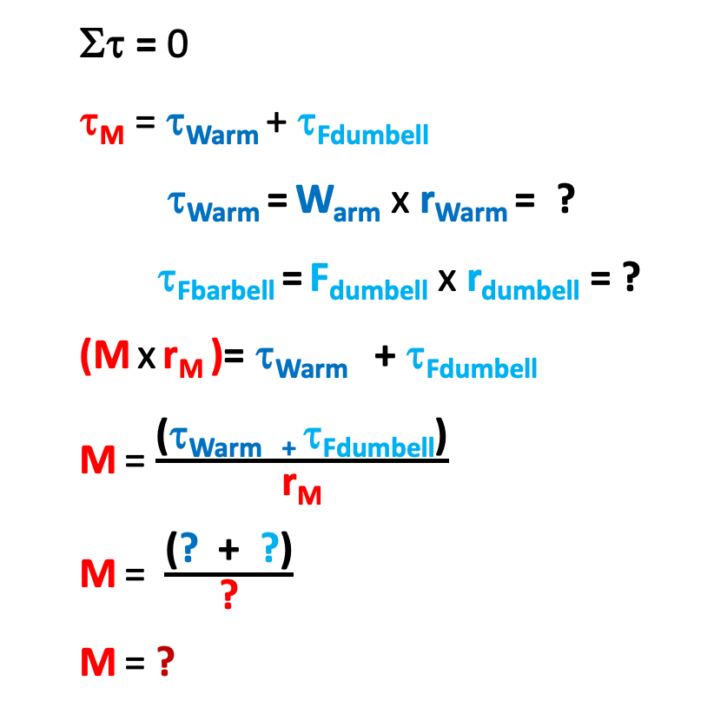
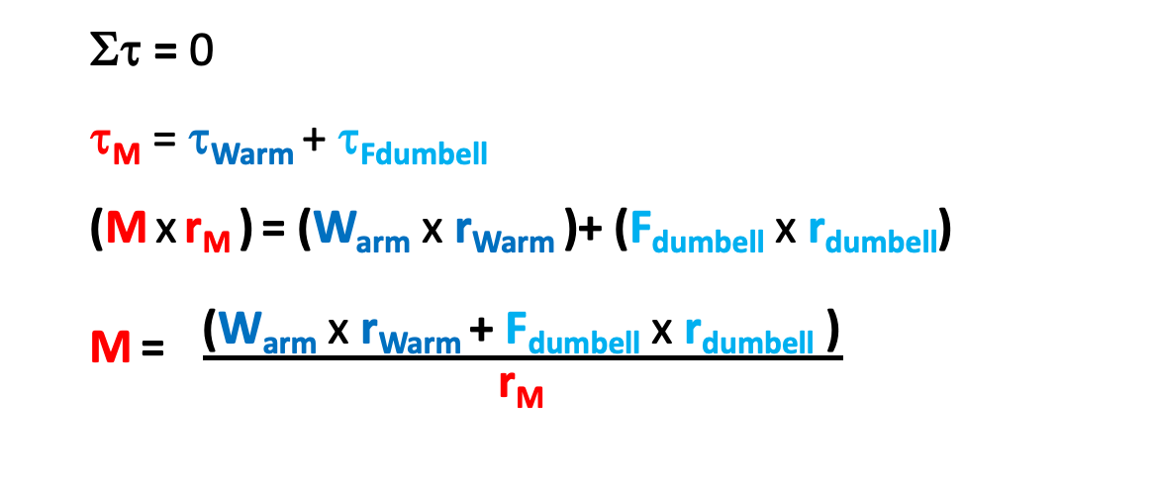

Method A
Method B
Στ = 0
τ_{M} = τ_{Warm} + τ_{Fdumbell}
(M x r_{M} ) = (W_{arm} x r_{Warm} )+ (F_{dumbell} x r_{dumbell})
M = $\frac{\text{(}\text{W}\text{arm} \text{x} \text{r}\text{Warm} \text{+ }\text{F}\text{dumbell} \text{x} \text{r}\text{dumbell} \text{)}}{\text{r}\text{M}}$
Στ = 0
τ_{M} = τ_{Warm} + τ_{Fdumbell}
τ_{Warm} = W_{arm} x r_{Warm} = ?
τ_{Fbarbell} = F_{dumbell} x r_{dumbell} = ?
(M x r_{M} )= τ_{Warm} + τ_{Fdumbell}
M = $\frac{\text{(}\text{τ}\text{Warm}\text{ + τ}\text{Fdumbell}\text{)}}{\text{r}\text{M}}$
M = $\frac{\text{(}\text{?}\text{ + }\text{?}\text{)}}{\text{?}}$
M = ?
M = $\frac{\text{(}\text{?} \text{x} \text{?} \text{+ }\text{?} \text{x} \text{?} \text{)}}{\text{?}}$= $?$
Need to know lever arm values for both methods
r_{Warm} = ?
r_{dbell} = ?
Are the results the same?
r_{M} = ?

Slide 14
ΣF_{forearm/hand} = 0
-W_{arm} - M_{triceps} – F_{dumbell} + J = 0
J = W_{arm} + M_{triceps} + F_{dumbell}
J = ?
Were we justified in neglecting the weight of the arm?

